Slide 1
Morphometric Analysis of Lunar Craters Using Chandrayaan-2 DTM Data
Group 24
Aditya Dubey - 12140100 Atharva Bhatnagar - 12140370 Ayushman Tripathi - 12140400

Slide 2
01
Morphometric Analysis of Lunar Craters using Chandrayaan-1 Data

Slide 3
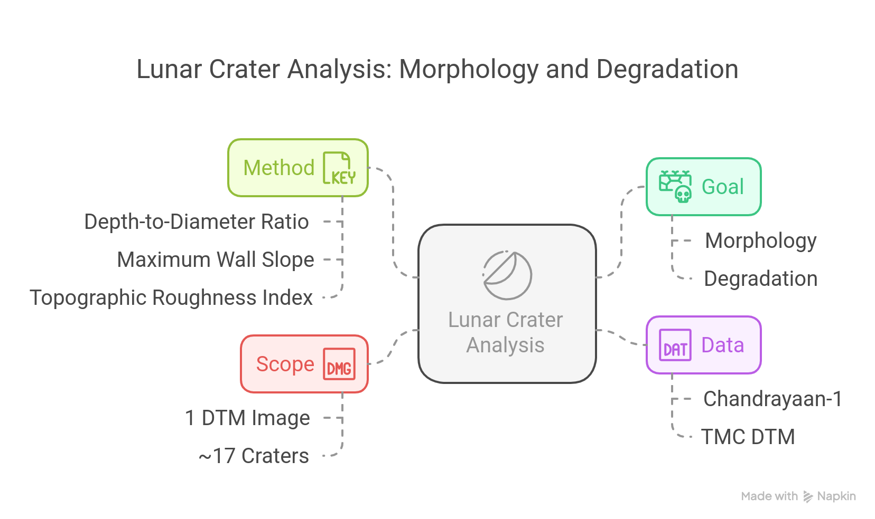

Slide 4
02
Identifying and Extracting Craters

Slide 5
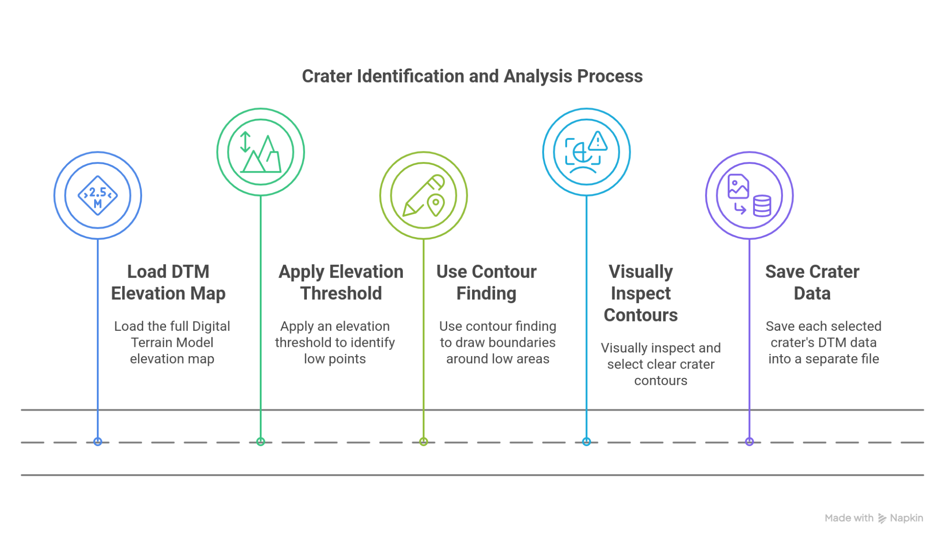

Slide 6
03
Measuring Crater Morphology: D/d, TRI & Slope

Slide 7
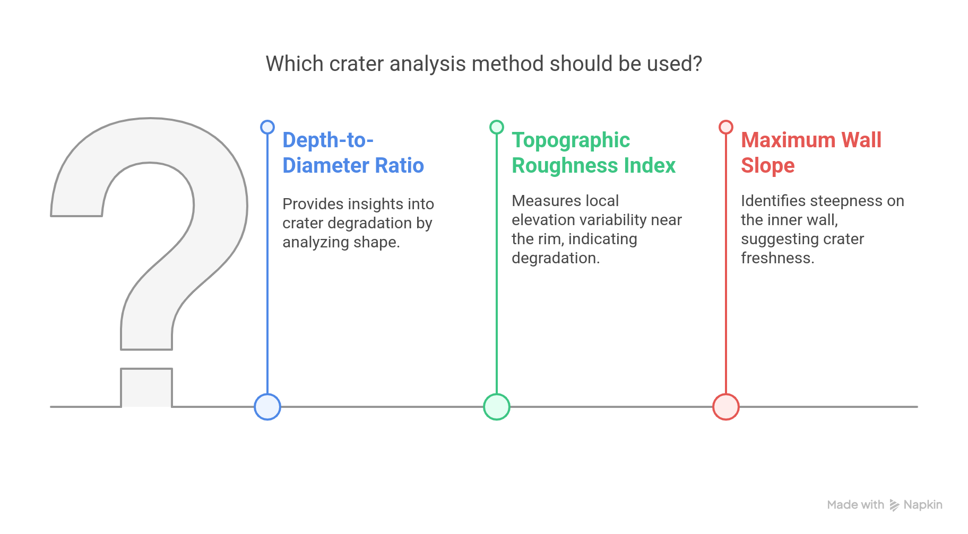

Slide 8
04
Findings and Observations

Slide 9
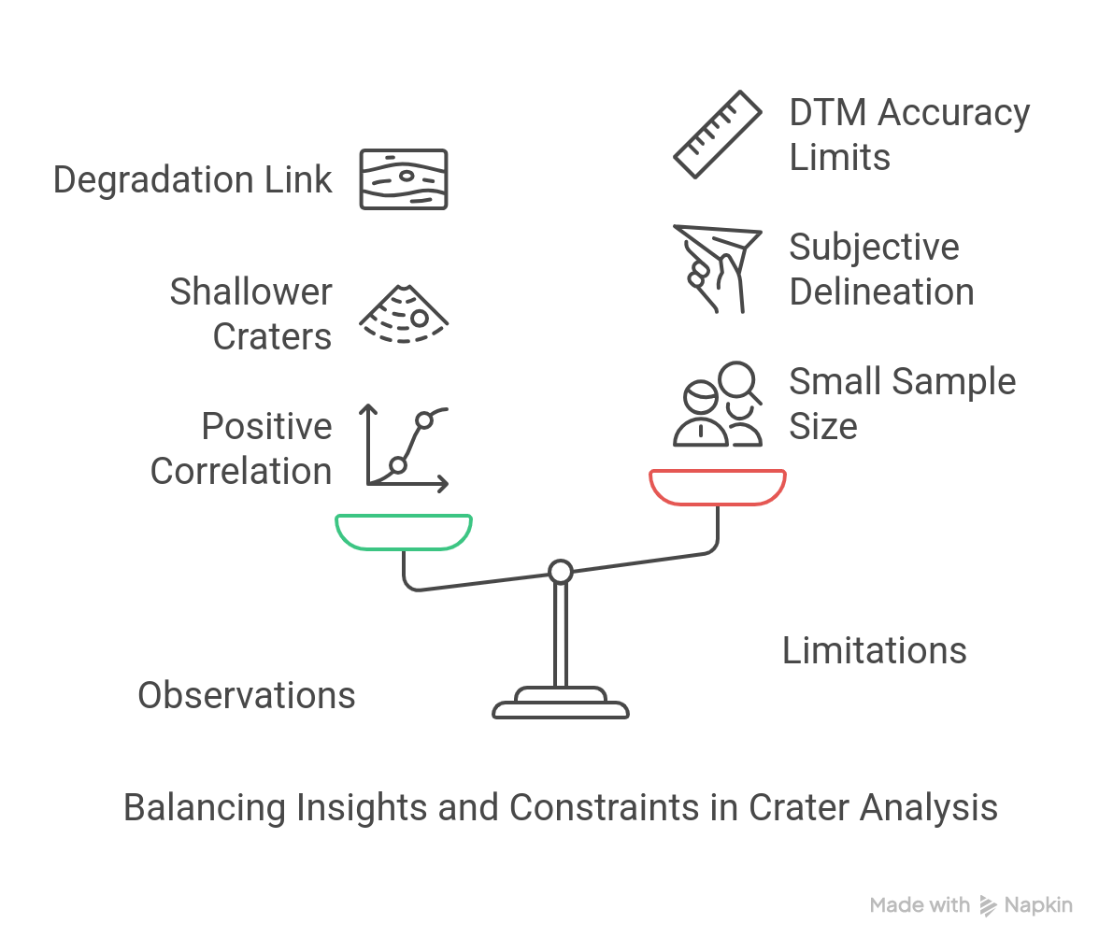

Slide 10
THANK YOU
COMPANY NAME

